Slide 1
BT201
Biochemical Process Calculations:
Multiphase system:Tutorial
18/10/2022

Slide 2
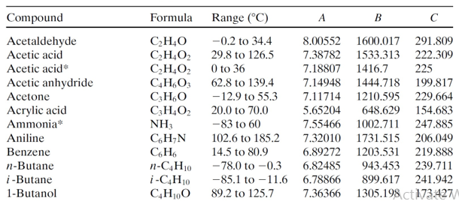
Problem 1
A gas containing nitrogen, benzene, and toluene is in equilibrium with a 40 mole% benzene–
60 mole% toluene liquid mixture at 100 °C and 10 atm. Estimate the gas-phase composition (mole
fractions) using Raoult’s law.
For Antoine Equation
Toluene 6.95805 1346.773 219.693

Slide 3
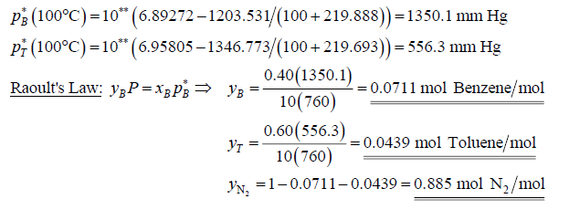

Slide 4

Problem 2
Using Raoult’s law or Henry’s law for each substance (whichever one you think appropriate), calculate
the pressure and gas-phase composition (mole fractions) in a system containing a liquid
that is 0.3 mole% N₂ and 99.7 mole% water in equilibrium with nitrogen gas and water vapor at
80 °C.
Henry’s constant
Vapour pressure of water at 80 °C =355.1 mmHg

Slide 5
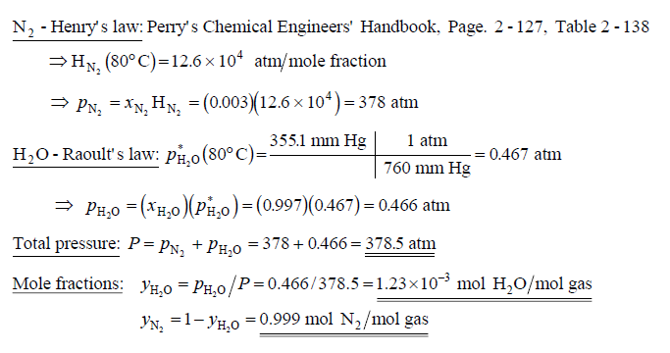
solution
Using Raoult’s law or Henry’s law for each substance (whichever one you think appropriate), calculate
the pressure and gas-phase composition (mole fractions) in a system containing a liquid
that is 0.3 mole% N₂ and 99.7 mole% water in equilibrium with nitrogen gas and water vapor at
80 °C.

Slide 6
Problem 3
Liquid methyl ethyl ketone (MEK) is introduced into a vessel containing air. The system temperature
is increased to 55 °C, and the vessel contents reach equilibrium with some MEK remaining in
the liquid state. The equilibrium pressure is 1200 mm Hg.
Use the Gibbs phase rule to determine how many degrees of freedom exist for the system at
equilibrium. State the meaning of your result in your own words.
Mixtures of MEK vapor and air that contain between 1.8 mole% MEK and 11.5 mole% MEK
can ignite and burn explosively if exposed to a flame or spark. Determine whether or not the
given vessel constitutes an explosion hazard.
Antoine equation: MEK A=6.97421 B=1209.6 C=216
7.06356 1261.339 221.969

Slide 7
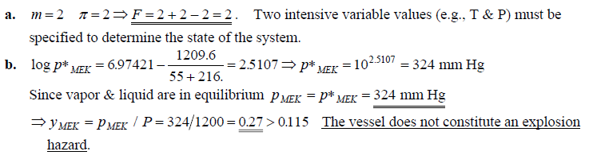
MAY USE ALSO: A= 7.06356 B= 1261.339 C=221.969

